Slide 1
You want to be more productive, but in the world of cellphones, instant messaging, social networks and cube life, it can be tough. In this session, you'll learn how to get more than 15 minutes of actual work done in a week by doing 3 simple things. Be m/ore productive and have more time to do the fun things you really want to do.

Slide 2

3 Simple Things for Increased Productivity
Codestock
Michael Eaton
@mjeaton

Slide 3


Slide 4

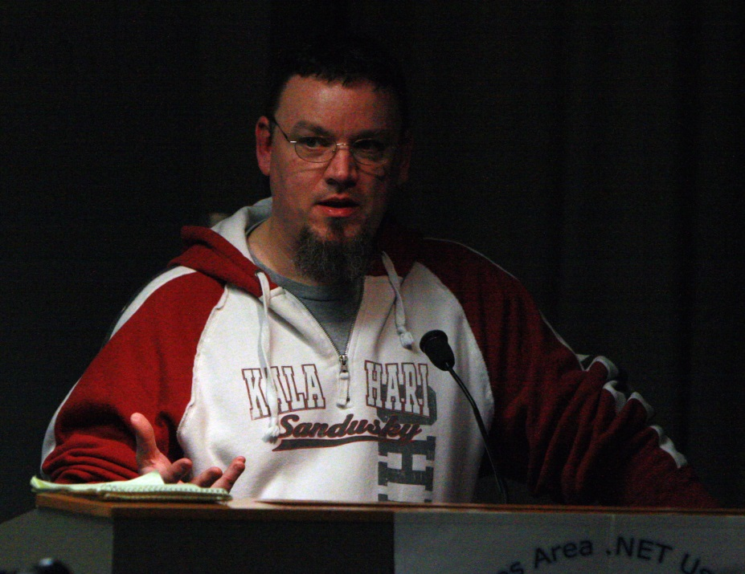
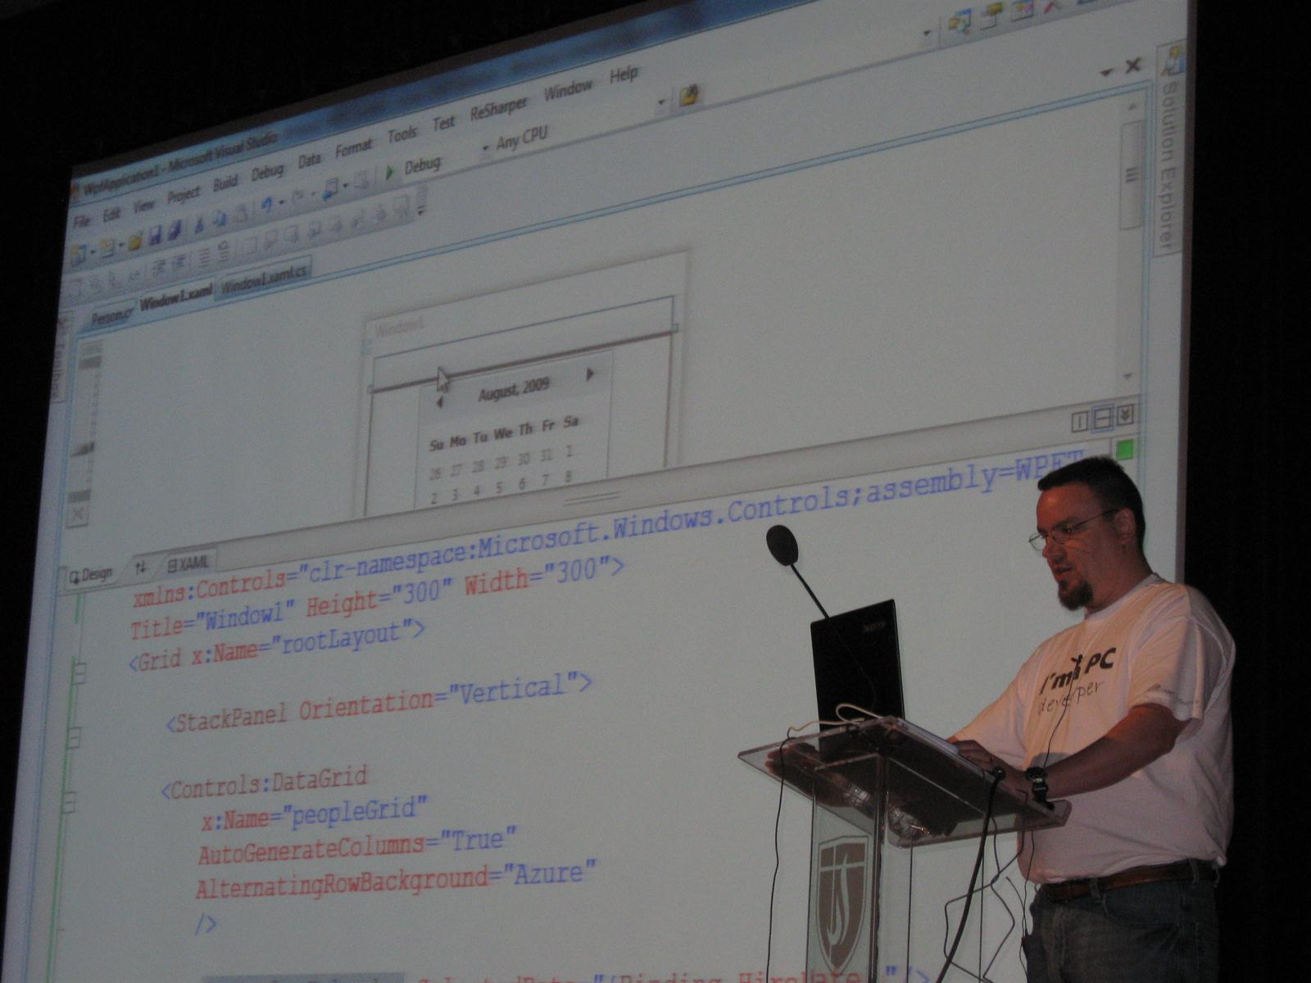
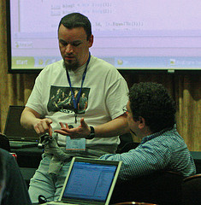

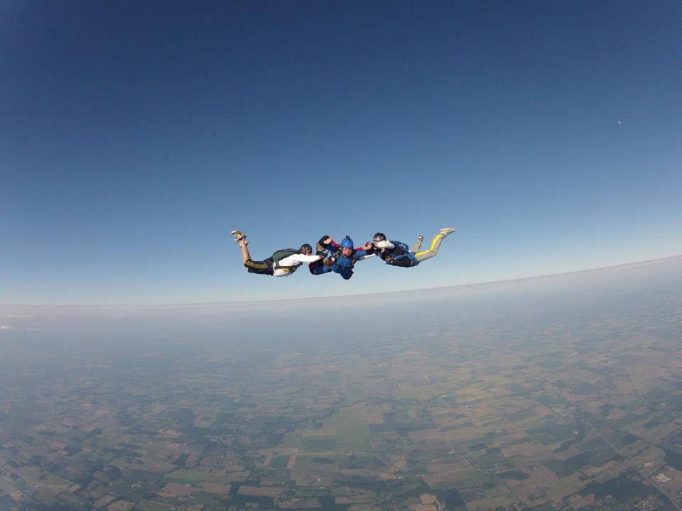

Slide 5

If parts of you don't change after #kalx13, you’re not listening.
"In a time where organizers are censoring speakers and their content, @mjeaton and @kalamazoox is a bastion of freedom. He is a luminary." "@mjeaton @kalamazoox believes in the open exchange of ideas, however uncomfortable, and trusts humans to think, collaborate and create."
"#kalx12 is like an All Star team of speakers. Every single one would have been the best talk at every other conference." "I've discovered @kalamazoox is a hidden gem. Today was like a braver, more profane set of dev-oriented TED talks. Lots of passion and humor."
Other confs are for the head, #kalx13 is for the heart.
#kalx13 part awesome insightful talks, part @mjeaton and friends roasting each other :)

Slide 6
about.me/mjeaton

Slide 7
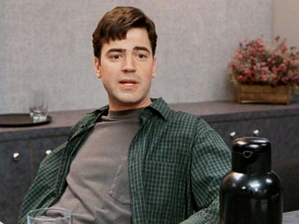
“I'd say in a given week I probably only do about fifteen minutes of real, actual, work.”

Slide 8
Productivity: the quality, state, or fact of being able to generate, create, enhance, or bring forth goods and services.
In business, a measure of worker efficiency, such as one hundred units per hour.
Notes:
Productivity: the quality, state, or fact of being able to generate, create, enhance, or bring forth goods and services.
In business, a measure of worker efficiency, such as one hundred units per hour.

Slide 9
Reduce or eliminate

Slide 10
distraction (dɪˈstrækʃən)
— n
1. the act or an instance of distracting or the state of being distracted
2. something that serves as a diversion or entertainment
3. an interruption; an obstacle to concentration
4. mental turmoil or madness
Notes:
distraction (dɪˈstrækʃən)
— n
1. the act or an instance of distracting or the state of being distracted
2. something that serves as a diversion or entertainment
3. an interruption; an obstacle to concentration
4. mental turmoil or madness

Slide 11
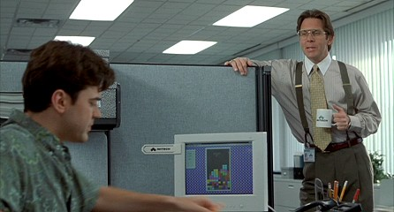
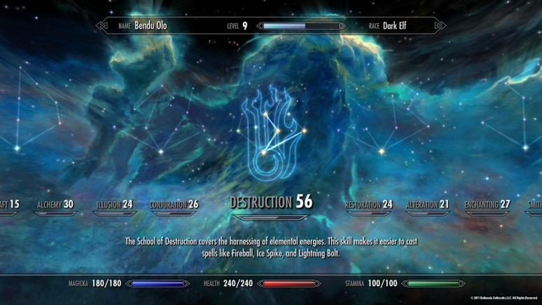

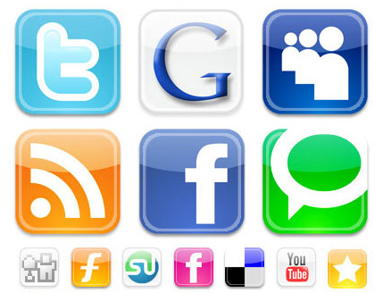

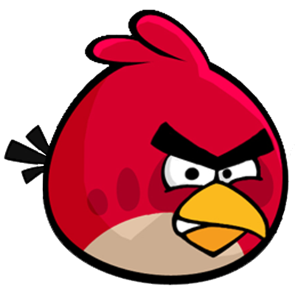

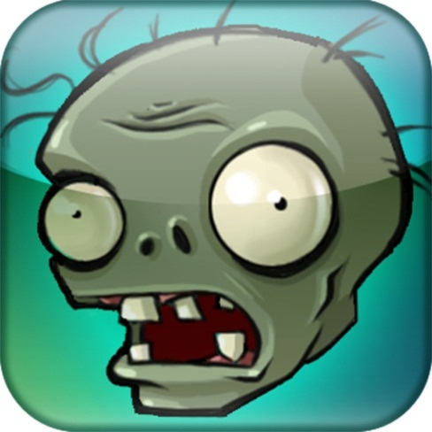

Slide 12
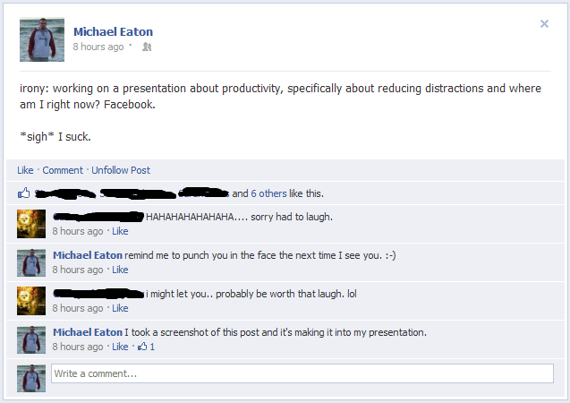

Slide 14


Slide 15
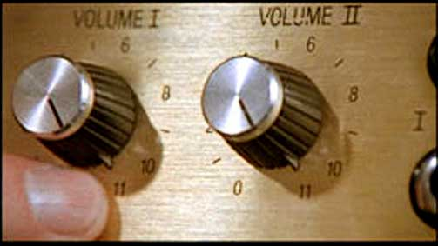

Slide 16
On my cube wall circa 1998
“Don’t waste your breath on me and I won’t waste my hate on you.”
Lyrics from Metallica’s “Wasting my hate”

Slide 17
Manage / Limit

Slide 18
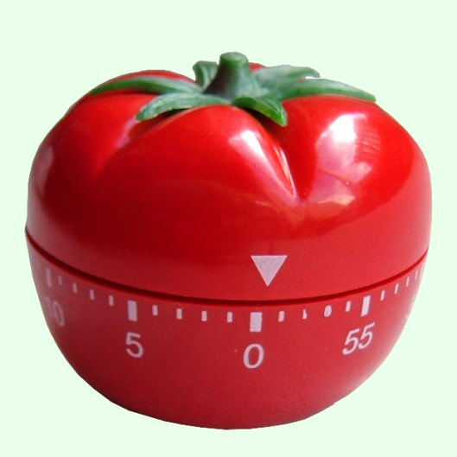

Slide 19
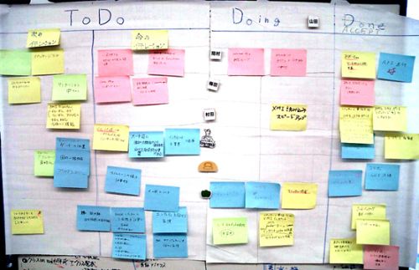

Slide 20
Relax

Slide 21
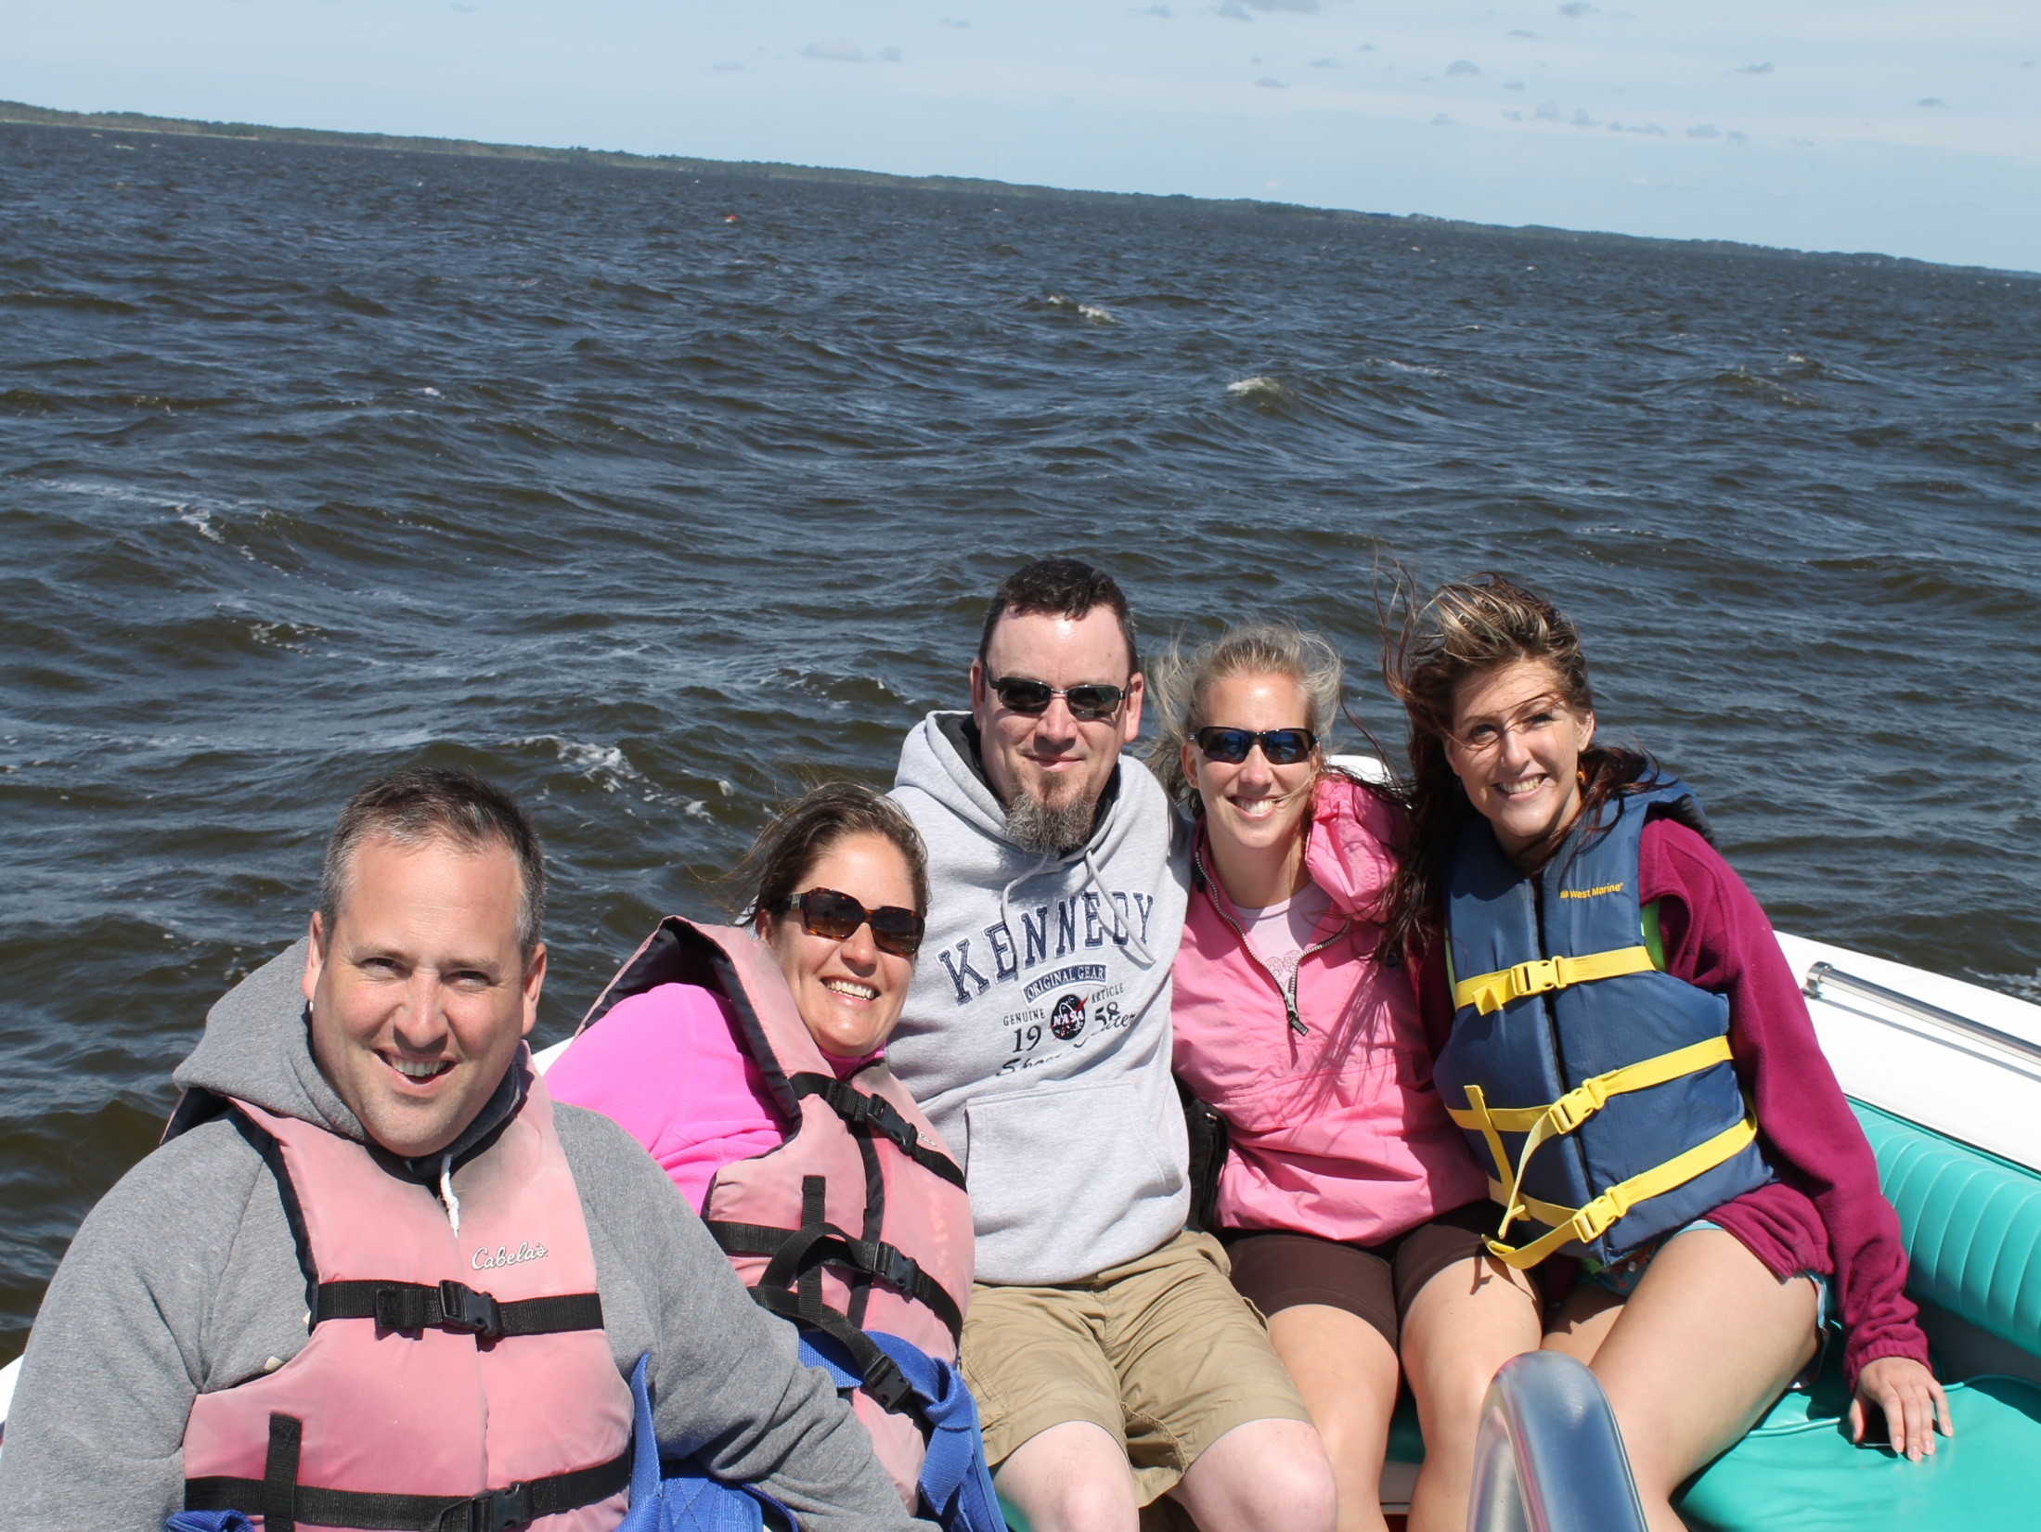

Slide 22
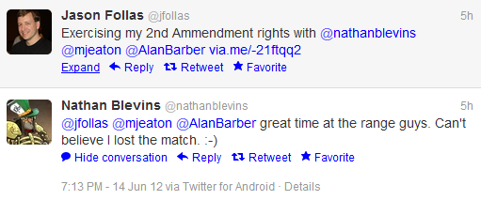

Slide 23
Contact Info
Email: mjeaton@validussolutions.com
Blog: http://mjeaton.net/blog
Twitter: @mjeaton
LinkedIn: http://www.linkedin.com/in/mjeaton

